Slide 1
Developing a Trading Strategy with Reinforcement Learning
Yogesh Kondasula/Samarth Marudheri
Notes:
1

Slide 2
Agenda
Problem Statement & Overview of Reinforcement Learning
Architecture & Roadmap
Results and Evaluations
ROI & Conclusion
2
Notes:
2

Slide 3
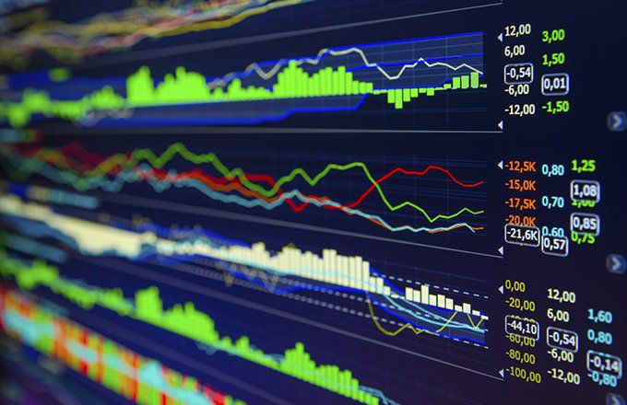
Problem Overview
Deep Learning in Automated Trading
Limitations of Supervised Learning
Dynamic constraints of the environment
(Liquidity/Transactional Costs/
Partial Information)
Limited to high frequency
trading scenarios
3
Notes:
3

Slide 4
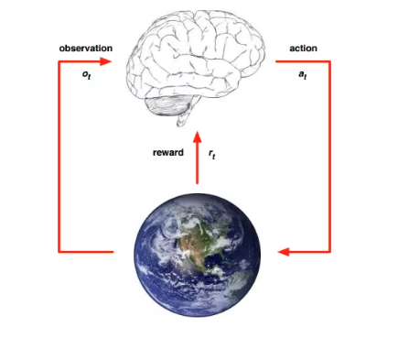
Reinforcement Learning
Premise of Reinforcement Learning
Learning through trial and error
Components of RL
State
Agent
Policy
Reward/Value
Discount
Value Based/Policy Based/
Actor-Critic
4
https://syncedreview.com/2017/02/24/david-silver-google-deepmind-deep-reinforcement-learning/
Notes:
4

Slide 5
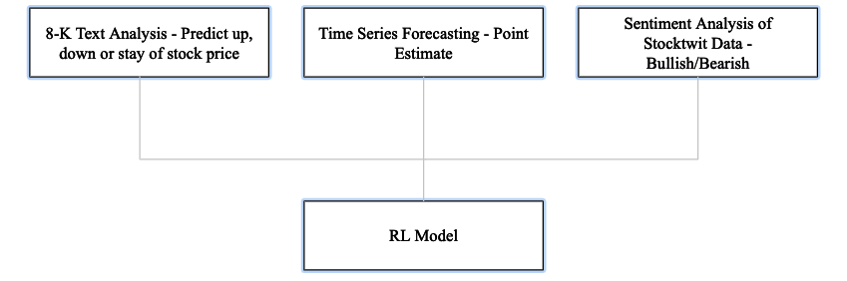
Architecture/ Roadmap
5
Notes:
5

Slide 6

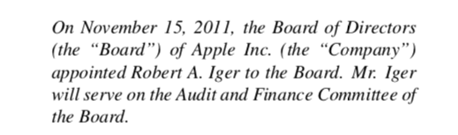
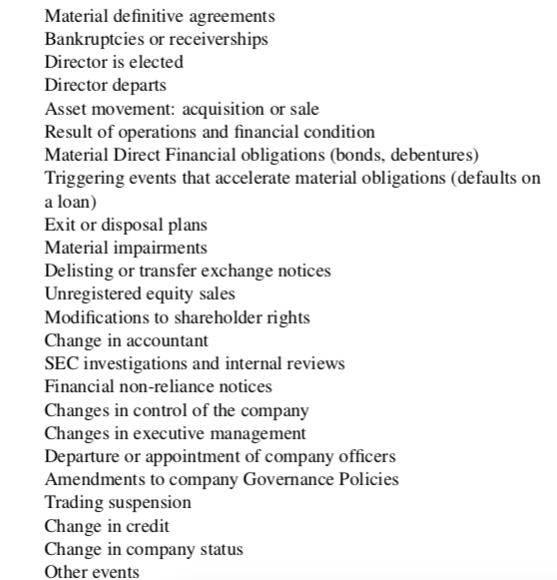
Text Analysis of 8-K Documents
What is a 8-K filing?
Categories of 8-K filings:
350 Documents for Apple and GE
from 2005 to 2019
6
Notes:
6

Slide 7
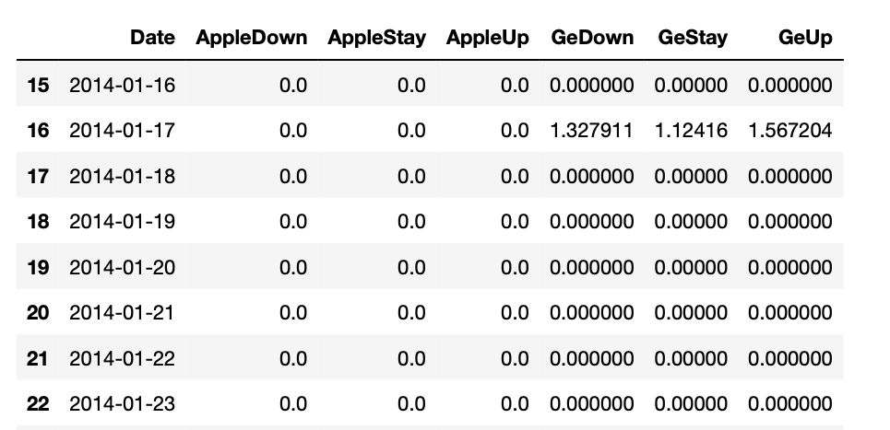
Text Analysis of 8-K Documents
Built 4 models : MLP model performed the best
Train Accuracy : 87 % and Test Accuracy : 69.9%
Sample Output:
7
Notes:
7

Slide 8
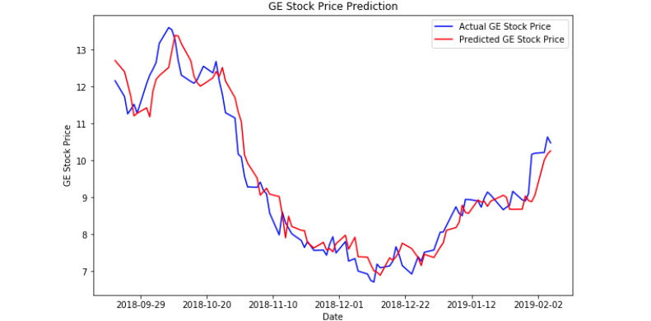
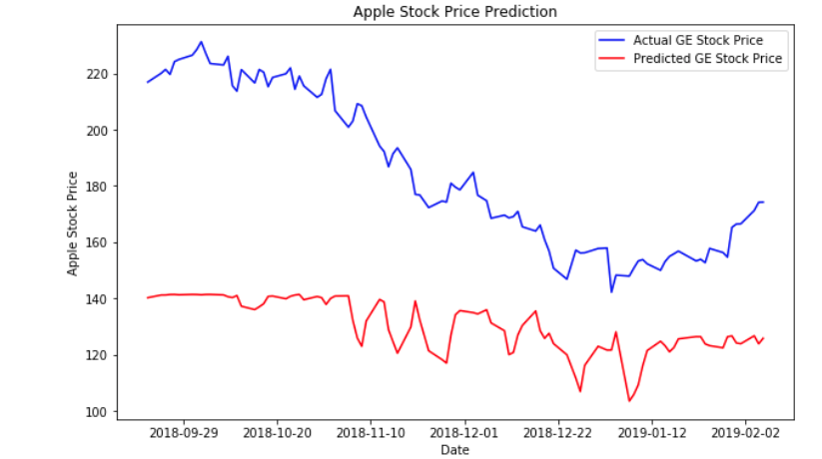
Time Series Forecast
LSTM model to forecast stock prices of both companies
Test Data Performance (GE and Apple):
8
Notes:
8

Slide 9
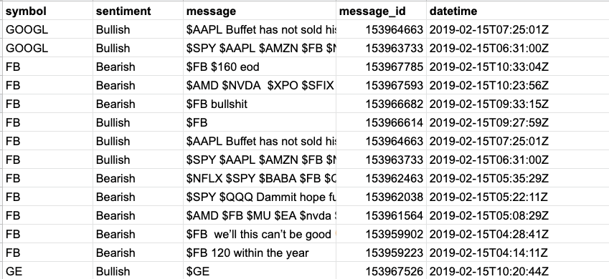
Stocktwit/Twitter Sentiment Analysis
What is Stocktwits?
Downloaded data for four months
This data will be added in the next stage of the project
9
Notes:
9

Slide 10
Reinforcement Learning Model Design
Actor Critic RL Model – Environment built in PyTorch
State : [Apple Holdings, GE Holdings, Current Portfolio Value, Cash, Apple’s Current Time step Opening Price, GE’s Current Time step Opening, Apple Five Day Average Stock Price, GE Five Day Average Stock Price, Apple Time Series Forecast, GE Time Series Forecast, 6 predictions from ML model] – Length : 16
Action Space: [Buy Apple, Sell Apple, Nothing, Buy GE, Sell GE]
Episode ends if agent runs out of money or tries to sell more stocks than it owns
Visualize PyTorch model
10
Notes:
10

Slide 11

RL Trading Strategy Results
Transactional cost is 10% to buy or sell
The RL model was trained for 360 epochs
For real time evaluation, 50 episodes were run on train data
Agent succeeded to finish 30 of 50 games
14 % average profit on finished episodes and 8.6% profit overall
11
Notes:
11

Slide 12
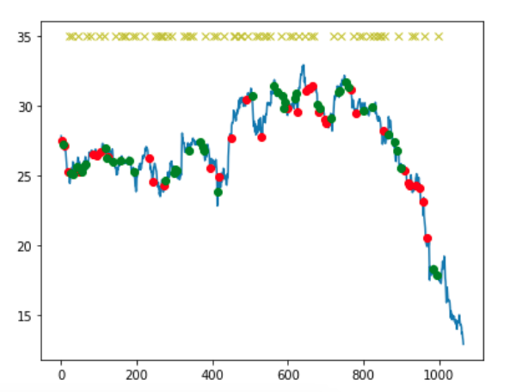
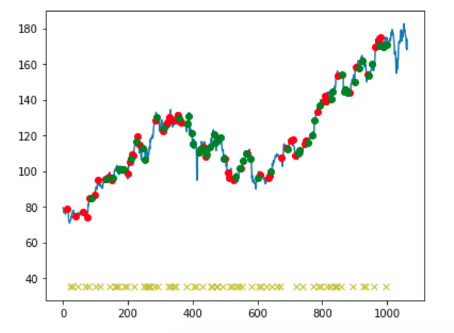
RL Trading Strategy Results
Agent behaviour for Apple shares
Agent behaviour for GE shares
12
Notes:
12

Slide 13
What have we achieved?
Scrape and run an effective text analysis for model change in stock price
Learnt to successfully build, manipulate and navigate the state of a Reinforcement Learning model with multiple signals
Built a stable end to end RL framework for automated trading
https://medium.com/@samarthmc/developing-a-trading-strategy-using-reinforcement-learning-d1b8c8e430e0
13
Notes:
13

Slide 14
What Next?
Revisit each base model to fine tune parameters
Experiment with different reward signals, states and train to learn better parameters for RL model
Experiment with multiple companies
Understand back testing better for trading
Scale and experiment with multiple companies
Compare across RL algorithms to for further insight
14
Notes:
14

